Slide 1


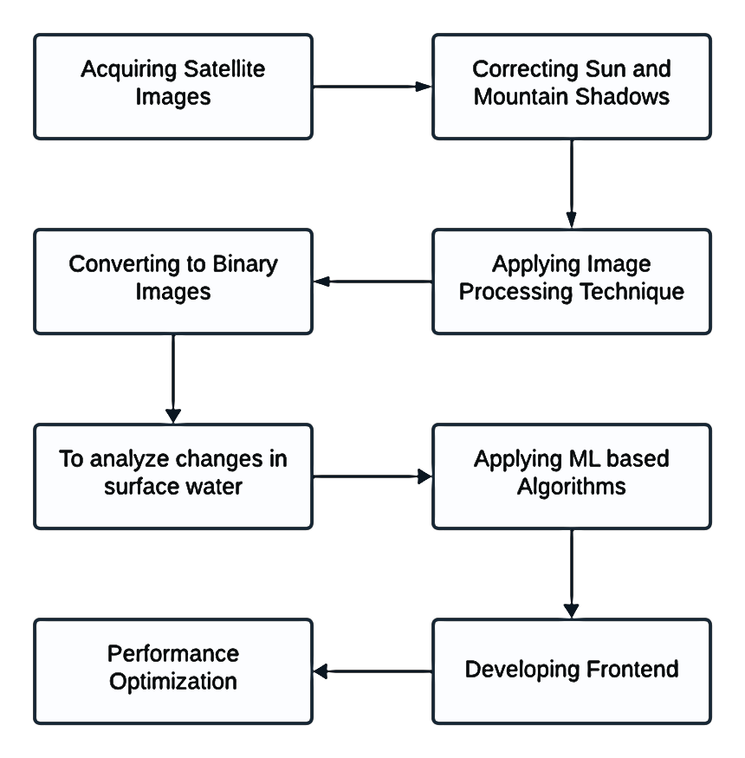
Department of Computer Science and Engineering
PBL I Poster Presentation
PROJECT TITLE: Demographic Location Surface Water Mapping
INTRODUCTION
Environmental Monitoring Urgency: As global urbanization accelerates and natural landscapes continue to be altered, there is a pressing need to monitor environmental changes such as land and water area. This monitoring is crucial to assess impacts on biodiversity, water security and water sustainability.
Advancements in Satellite Imagery: The Landsat 8 OLI imagery, provided by USGS, offers high resolution, multi-spectral data that can effectively monitor environmental changes over time. This image is instrumental in capturing detailed changes in land and water area.
Enhanced Image Analysis Techniques: The project employs the MNDWI and advanced shadow correction algorithms to improve the accuracy of water body detection in satellite imagery.
Machine Learning Applications: The application of machine learning algorithms such as Linear Regression, Polynomial Regression, Random Forest, Gradient Boosting, SVM, KNN and Neural Networks to satellite data presents an approach to predict future environmental conditions. These models help in understanding complex patterns and trends that manual analysis can miss.
Data-Driven Decisions: By analyzing satellite imagery with advanced machine learning techniques, our aim is to provide accurate predictions of water and land area. These predictions are essential for policymakers, urban planners, and environmentalists to make informed decisions for environmental preservation.
Technological Integration and Accessibility: The project extends its utility through a web application that makes the findings accessible and interactive. This platform allow users to explore data, understand trends and retrieve predictions, thereby enhancing the impact of research and its applications in real-world scenarios..
METHODOLOGY
Fig 1. Flowchart of Methodology
ALGORITHMS USED:
Linear Regression, Polynomial Regression, Random Forest, Gradient Boosting, SVM, KNN and Neural Networks
EQUATIONS USED:
MNDWI: Band 3 - Band 7/ Band3 + Band 7
Sun Correction: Band/sin(sun elevation in radian)
DATASET
Source: https://earthexplorer.usgs.gov/
Size: 93.3 GB
Temporal Coverage: From January 2014 to December 2023
Spatial Coverage: Path: 147
Row: 047
Region: Pune District
Dataset Characteristics: Resolution: The Landsat 8 OLI images offer a resolution of 30 meters.
RESULTS:
Fig 2. Comparison of Accuracy of different Algorithms
Fig 3. Comparison of RMSE of different Algorithms
OBJECTIVES & AIMS:
Advanced Environmental Monitoring: Utilize high resolution Landsat-8 satellite imagery to accurately monitor and analyse changes in water bodies. This includes detailed preprocessing and precise labelling of imagery for trend analysis.
Development and Application of Predictive Models: Develop and implement advanced machine learning models to predict future environmental changes. These models aim to enhance the predictive accuracy and reliability of environmental trend forecasts, making them valuable tools for decision-makers.
Scientific Contribution and Support for Sustainability: Advance scientific research in environmental monitoring using satellite imagery and machine learning. Use the insights generated from the project to support sustainable development goals and provide actionable recommendations for policymakers and urban planners.
CONCLUSION AND FUTURE SCOPE: This project utilizes Landsat-8 satellite imagery and machine learning to identify and predict environmental changes providing crucial data for sustainable development and policy making. The future scope of this project can be to perform periodic updates and track the dynamics of water bodies, which could be valuable for long-term water resource management and urban planning.
GROUP MEMBERS: Abhishek Rajput(22070122007), Arnav Jain(22070122030), Atul Goyal(22070122039), Janmejay Pandya(22070122086)
PROJECT MENTOR NAME: Dr. Nilima Zade

